Slide 1
Netflix Recommender System

Slide 2
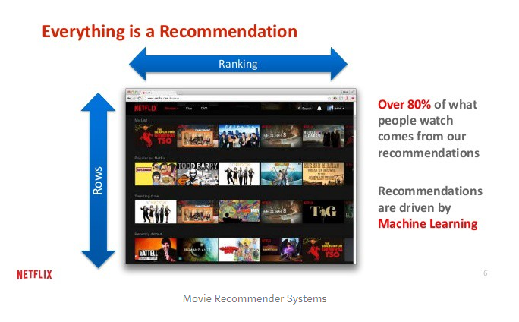
INTRODUCTION:
:

Slide 3
METHODOLOGY:
Development Environment –
Jupyter Notebook was adopted as the development environment writing and executing our code. We used python as a programming language since it provides a wide variety of machine learning algorithms. By using these resources, we build a machine learning model for predicting (recommendation) system to our dataset.
Data Gathering –
We Used three Datasets for this project.
Dataset collected from flixable is used to implement graph based recommendation engine using Adamic Adar measure by exploring content from different countries, identifying similar content of tv shows and movies by Frequency-Inverse Documnt Frequency (TF-IDF)
The Full Dataset: Consists of 26,000,000 ratings and 750,000 tag applications applied to Forty Five Thousand movies by 270,000 users. Includes tag genome data with 12 million relevance scores across One Thousand One Hundred tags.
The Small Dataset: consists of One Lakh ratings and One Thousand Three Hundred tag applications applied to Nine Thousand movies by Seven Hundred users.

Slide 4
Data Pre-processing
Data Preparation –
Select the applicable information, which means diminishing the information volume by improving the information quality.
Normalize the data, eliminating some extreme values in the ratings per user
Data Analysis –
To Analyse the Data :
Understand every category in the rating column.
Need to understand what content is available in different countries.
Whether Netflix has increasingly focusing on TV shows or movies in recent years.
Understand the most observed rating categories in Movies and TV shows.
Identifying similar content by matching text-based features using TF-IDF.

Slide 5
Continuation…
VARIOUS METHODS OF BUILDING A MOVIE RECOMMENDER SYSTEM:
K-Means clustering with TF-IDF
K-Means clustering is an unsupervised learning algorithm that will attempt to group similar clusters together in our data. The overall goal is to divide data into distinct groups such that observations within each group are similar. Based on the cluster, recommendation was then done, one of the advantage of this clustering method is that it scales well with large dataset.
TF-IDF (frequency-inverse document frequency) –
Assessing word relevancy via term TF-IDF
The tf-idf is the term frequency and the inverse document frequency represented as:
tf-idf(t, d) can be calculated as:
tf-idf (t, d) = tf (t, d) * log(N/(df + 1))
tf-idf(t,d)=tf (t,d)×idf(t,d)tf-idf(t,d)=tf (t,d)×idf(t,d)

Slide 6

Continuation…..
ADAMIC ADAR MEASURE:
It is used to measure the closeness between nodes based on their shared neighbors.
Machine Learning:
We employed the method of a recommender that is based on clustering and various filtering methods to build our recommendation systems. There are basically four types of recommender systems:
Demographic Filtering
Content-based Filtering
Collaborative Filtering
Hybrid recommender system

Slide 7
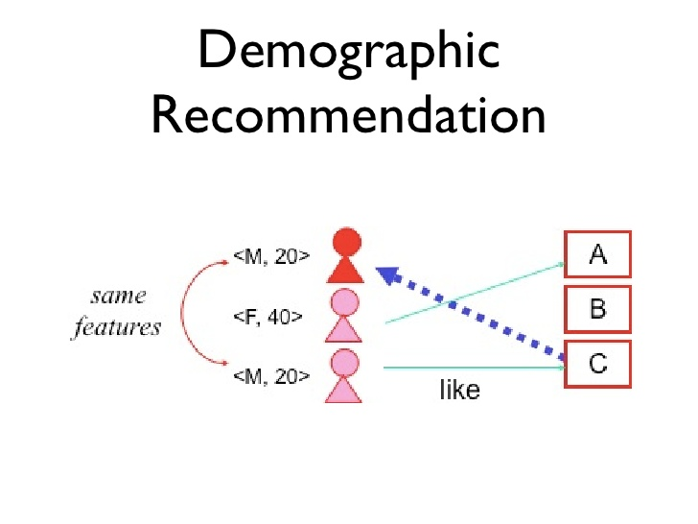
Continuation…..
Demographic Filtering:
This approach offers generalized recommendations to each user or client, based on general details of movie like popularity and/or genre or rating. Since each user is different, this approach is considered to be too simple so this approach is also called as a simple recommender.

Slide 8
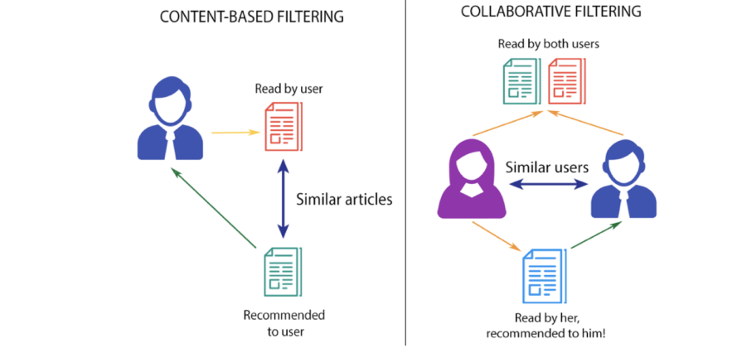
Content Based Filtering:The general idea behind these recommender systems is by looking at user specific classification problem, to understand if a person liked a particular item and same person will also like an item that is similar to it.
Collaborative Filtering:The Basic Idea of Collaborative Filtering is, Suppose we have a User 1 and want to find the recommendation to him/her we will first find User 2,whose likes and dislikes are similar to User 1 and we call him/her as neighbourhood of the User 1, Finally we find other Movies that are liked by the User 2 and recommend those items to User 1.

Slide 9
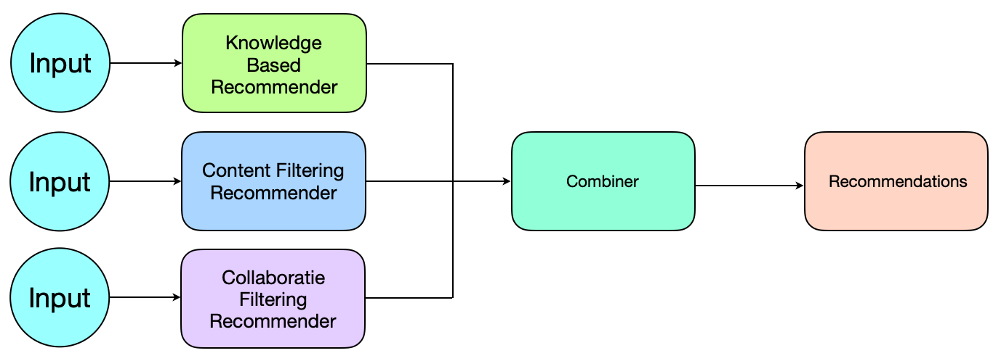
Hybrid Recommender System: The combination of content-based filtering, collaborative filtering and Knowledge Based Filtering to build an engine is called hybrid system. This system gave movie suggestions to a particular user based on the estimated ratings that it had internally measured for that user. If we combine both of the filtering methods together then the benefit can be used to overcome issues of others.

Slide 10
EXPERIMENTS AND DISCUSSIONS:
The first model we implemented was a K-Means clustering using Adamic adar measure to represent the recommendations in a graphical form later on we implemented demographic filtering which is used to recommend the popular movies in the dataset is also named as Popularity recommender model, this was achieved by listing top 6 movies with the highest watch count in the dataset, but this model gives the same recommendation to every user without personalization, so we decided to implement Content-based, collaborative and hybrid filtering recommendation models.
These models suggest based on the attributes of an item and the users preferred profile using item metadata such as cast, crew, keywords, genre, director, description, etc. for movies to understand if a person liked a particular item and same person will also like an item that is similar to it. And finally we come up with hybrid recommender it is the combination of both content based and collaborative filtering.

Slide 11
CONCLUSION:
In this project, we have built 5 different recommendation engines based on different algorithms with different ideas. They are as follows:
Demographic Recommender: This is a simple recommender it used total TMDB vote averages and TMDB vote counts to build Top popular Movies Charts, in general and for a specific genre to all the users we will get same output. To sort final ratings we used the IMDB Weighted Rating System for better performance.
Content Based Recommender: We built two content based engines; one that took movie overview and taglines as input and the other which took metadata such as cast, crew, genre and keywords to come up with predictions. We additionally deviced a straightforward channel to give more noteworthy inclination to films with more votes and higher appraisals.
Collaborative Filtering: We used the powerful Surprise Library to build a collaborative filter based on single value decomposition. The RMSE obtained was less than 1 and the engine gave estimated ratings for a given user and movie.
Hybrid Engine: We brought together ideas from content and collaborative filtering to build an engine that gave movie suggestions to a particular user based on the estimated ratings that it had internally calculated for that user.
K-Means clustering with TF-IDF Using Adamic Adar Measure: KMeans clustering was implemented by creating a cluster of movies in the dataset. The clustering was based on user watch history. Based on the cluster, recommendation was then done, one of the advantage of this clustering method is that it scales well with large dataset.

Slide 12


